Slide 1

ENME480 Labs
Week 1 - Basics
Alex Beyer, Kaustubh Joshi

Slide 2
Introductions
Alex Beyer
  5th Year PhD, undergrad in Mechanical Engineering @ UDelaware
  Research work in bioinspired robotics, covert communications and robotic metareasoning
Kaustubh Joshi
  4th Year PhD, undergrad in Ocean Engineering @ IIT Madras
  Research work in underwater robotics, state estimation and control

Slide 3
Todays Plan
  Lab Structure & Grading Policies
  Lab Schedule & Class Goals
  Final Project Description
  Overview of Hardware & Software
  Online Safety Training & Lab Group Survey

Slide 4
Lab Structure
Two rooms:
  KEB2111 (here!)
  IDEA3119
Safety training for IDEA3119 next week!
  Let the TAs know ASAP if you can’t make it

Slide 5
Lab/Homework Grading
Homework:
  Course homeworks are designed as practice for important skills
Labs:
  Groups will be assigned soon(™), most lab assignments will be group based
  Each topic will have a few studio sessions in Kim followed by one or more weeks in RAL to get data, the writeup will be due before the next lab session
We are fairly flexible with deadlines, but we release answer keys after assignments are due

Slide 6
AI Usage Policy
Don’t.

Slide 7
AI Usage Policy
AI is good for getting really broad, high level topics down
Using AI effectively requires you to already have some knowledge about what you’re asking it. This is an intro class, you probably aren’t there yet.
AI is really bad at getting specifics right and tends to be confidently wrong – how many ‘r’s are in strawberry?
Using Generative AI to write code which will run on the robots means you won’t be allowed to use the robots again!

Slide 8
Schedule
Weeks | Lab
1-4 | Introductions, Python, ROS, Ubuntu, Gazebo
5, 6 | Forward Kinematics
7 | Makeup/Open Lab (Fall Break, Exam 1)
8-10 | Inverse Kinematics
11, 12 | Cameras
13 | Makeup/Open Lab (Thanksgiving)
14, 15 | Final Project
This is all in the syllabus!

Slide 9
Goals
Final Project
  Vision Enabled Pick & Place Task using UR3 Arms
  Final Project is the final (25% of overall grade)
Labs will walk you through each step involved in building the project (another 25% of overall grade)

Slide 10
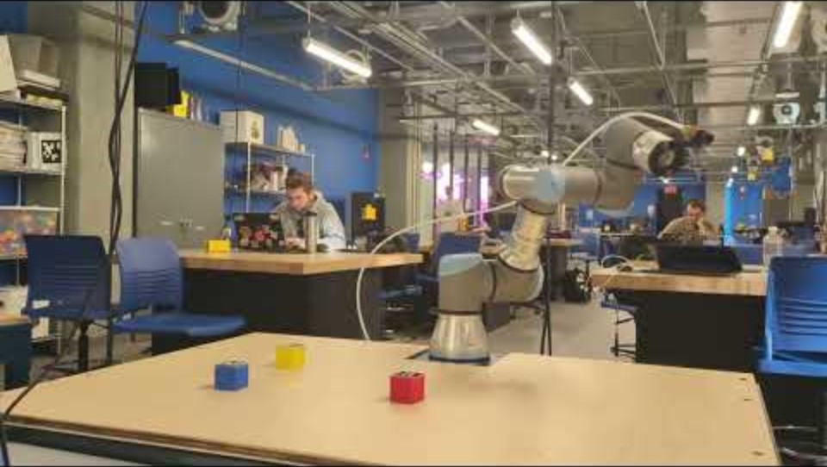
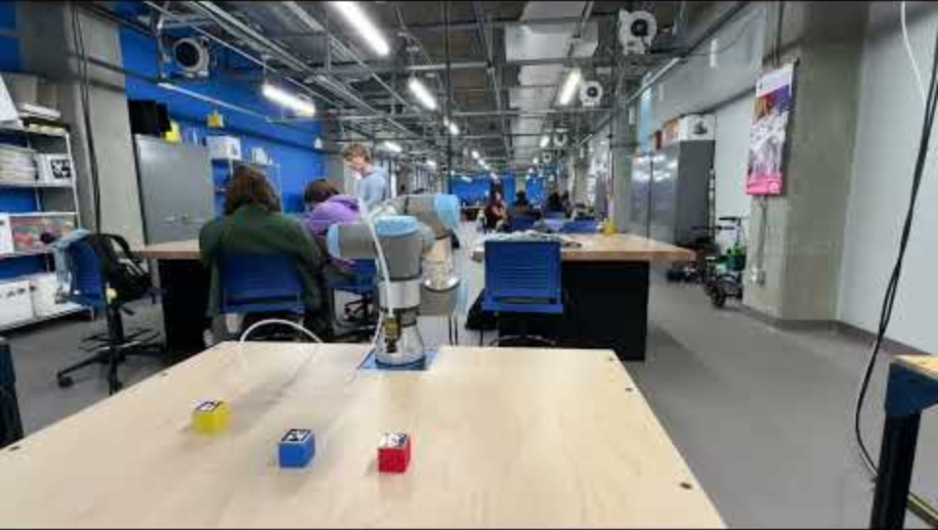
Goals
Credit: Robsun Gina (student from last years class)

Slide 11
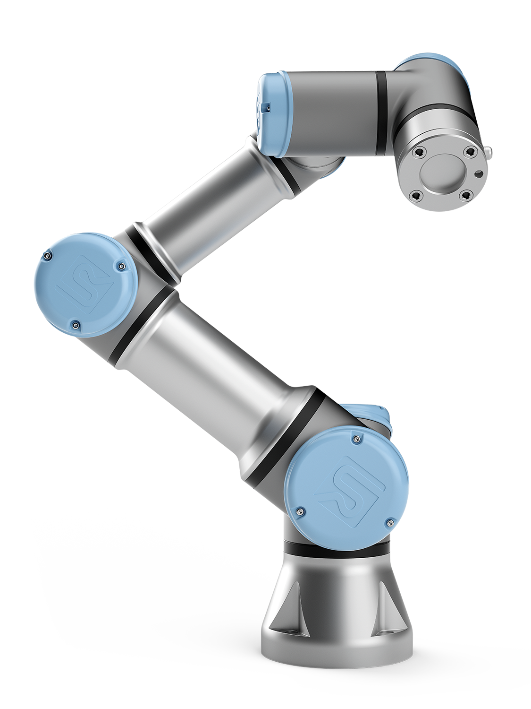
Hardware
Universal Robotics UR3e Robotic Arms
  6 DoF Robot
  3kg payload
  Built in user tablet
  Supplied ROS drivers to make programming easier & operation safer

Slide 12


Software
Ubuntu 22.04 with ROS2 (Humble Hawksbill)
  Premade Docker image is available
  We strongly recommend you use Docker
    VirtualBox works but can cause bugs
    VMWare Fusion Pro is free but requires a Broadcom account
    Dualbooting is another option for more advanced users
    WSL2 also offers ROS2 support
    Native Windows/OSX support is not good
  We aren’t planning to offer support for non-Docker installs
Preferred Python Code Editor (i.e. VSCode)

Slide 13

Why Ubuntu?
Ubuntu is a Linux based OS designed using primarily Free and Open Source Software (FOSS)
  Nothing is closed to the user; its extremely customizable
  Easy to mod
  Runs on almost any hardware made in the last decade
  Software support isn’t always great
We will give a more in depth tutorial on Ubuntu next week

Slide 14

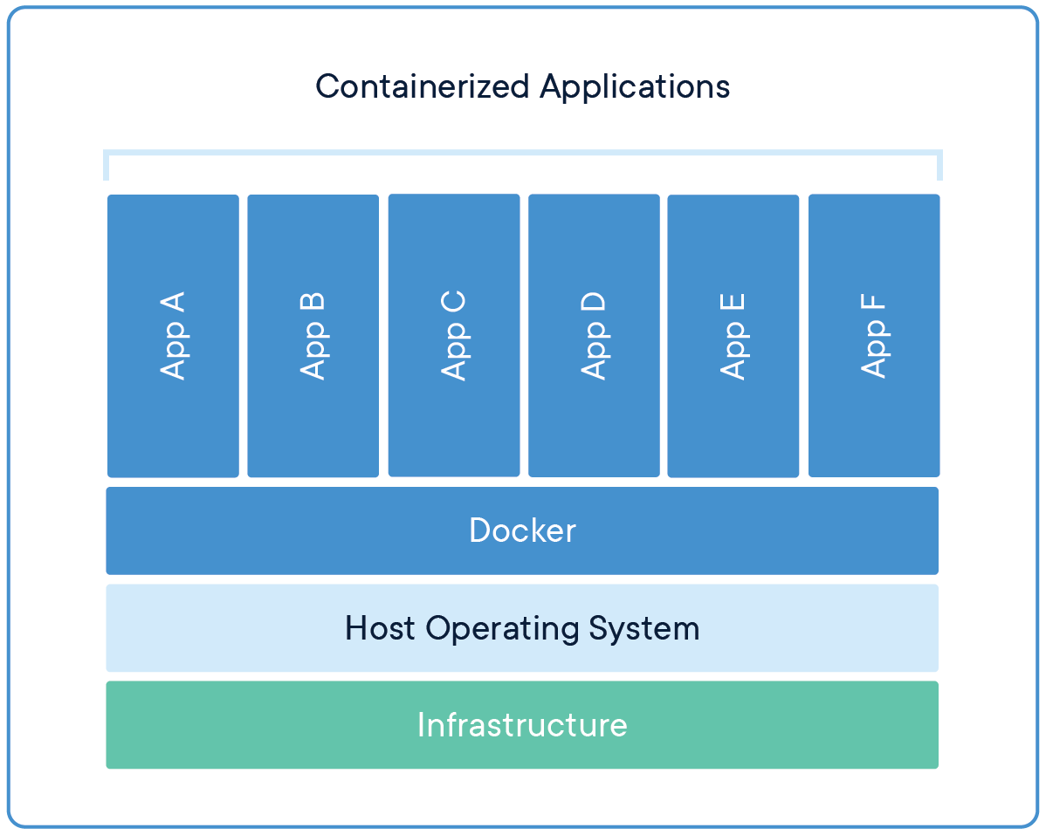
Docker
Let’s you package a bunch of settings and programs into an image that anyone can load and instantly get to a known-stable state
Can be broken then deleted and reinstalled easily to get back to a working state
Super useful for things that break easily, like ROS!

Slide 15
Virtual Machines
Every computer has an Operating System (Windows, MacOS, …) but not all programs run on every OS
VMs let you run one OS within another
  For example, ROS has poor Windows support and absolutely no Mac support, but it’s made to run on Ubuntu Linux
VM
VM
Hypervisor
(VMWare, VirtualBox)
Native OS
(Windows, Mac)
Hardware

Slide 16
The Robotics Operating System (ROS)
Modular, open source middleware designed to be a common way of working with robots
ENME480 teaches how to use ROS to develop, test and deploy code from one environment

Slide 17

Deliverables
Next weeks lab will meet here before heading to RAL for an intro and safety briefing, arrive on time!
Robot safety training: academy.universal-robots.com/free-e-learning/e-series-e-learning/
Class survey: go.umd.edu/ENME480-25-Survey
Course wiki: enme480.github.io/

